Slide 1
Benefits Overview

Slide 2
Your Logo Here
We understand the importance of having access to benefits. We are pleased to announce that you are now eligible to participate in a comprehensive voluntary benefits package plan designed to meet your needs.
Medical Plans
Dental
Vision
and more!
The partnership between Association and Brokerage have brought you the benefits available that are powered by BENAdvance.

Slide 3
Medical

Slide 4
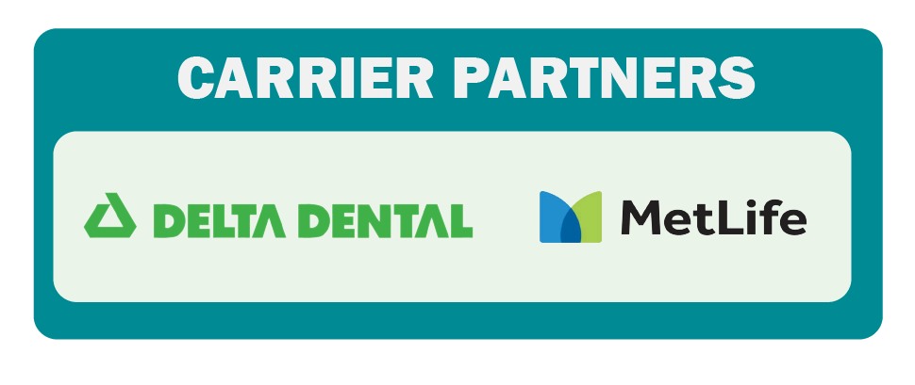
Dental

Slide 5
Vision

Slide 6
Life Insurance
Guaranteed Issue term life up to $50,000
No medical questions
No background check
Fill out the application and you are approved!!!
Higher limits require limited underwriting

Slide 7
Gap Insurance
Accident Insurance
Protection from the out-of-pocket costs expenses related to your insurance.
Cash payout to help cover costs resulting from an accident.
Reimburses for hospital, lab, surgery, anesthesia, x- ray, doctor’s visits, ambulance.
Cost under $10/month.
Hospital Indemnity
Pays a benefit directly to you for hospital-related events.
$1,000 per admission.
$150 a day of hospital confinement.
Costs range $10-$25/month
Critical Illness
Pays a lump sum benefit upon diagnosis of a critical illness.
$10k coverage
Covers over 20 serious illnesses, plus 21 childhood illnesses including cancer, heart attack, stroke, transplant.
Cost $2.66-$20 per month.

Slide 8
Get Covered Today!
Small monthly fee to access these special benefits.
Association has over 25,000 members nationally and is registered with the Department of Labor and NYDFS.
Must complete a Pre-Medical Screening questionnaire for proof of good health.
Medical plan enrollment is not guaranteed.
Enrollments and terminations need to be completed by the 18th of the month for it to be effective the 1st of the following month.

Slide 9
We’re Here for YOU
Expert Assisted, Technology Driven
BenAdvance is committed to providing expert guidance to Sales Associates through a needs-based buying experience.
Proven Benefits
We offer a comprehensive portfolio of voluntary benefits, guaranteed issues, no questions asked.
* Please note that medical coverage is not guaranteed. Pre-medical screening is required to determine eligibility.
Simple Billing
Once a benefit decision is made, premiums will be deducted via ACH.
Customer Support
BenAdvance offers a customer service team to assist with ongoing questions.

Slide 10
How to Get Started
Enrollment is on-going. You can sign up at any time and terminate at any time.
You can access an exclusive Association Site to book an appointment
You can review the plan options or self enroll at:
https://brokerexchanges.com/nnpen
After you are officially enrolled in benefits, you will create your own personal dashboard where you can see your account or add other products whenever you like.
BENAdvance administers program and handles all enrollment and service inquiries.

